Slide 1
DataBase System

Slide 2
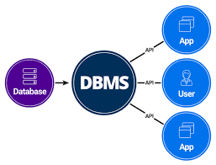
INTRODUCTION
Database system has three components :-
APPLICATION END
DBMS Software
Database

Slide 3
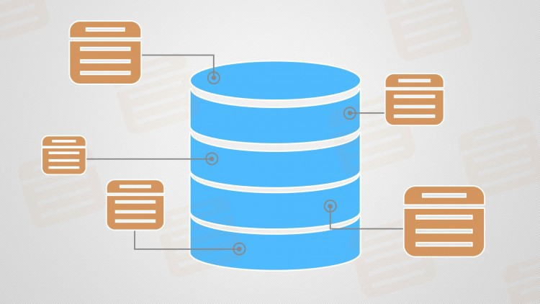
Database
Database: Database is a collection of inter-related data which helps in efficient retrieval, insertion and deletion of data from database and organizes the data in the form of tables, views, schemas, reports etc. For Example, university database organizes the data about students, faculty, and admin staff etc. which helps in efficient retrieval, insertion and deletion of data from it.

